Slide 1
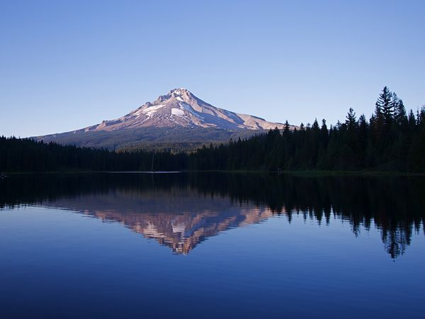
Dynamic Model Builders
Final Presentation
Klein Research Group
Mentor: Mathew Colgrove
Department of Chemical and Biomolecular Engineering

Slide 2
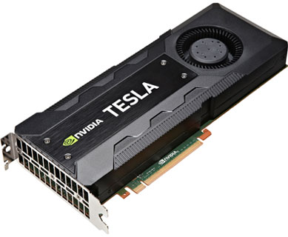
Goals
Take advantage of HPC hardware
Learn about coding in the GPU
OpenACC
CUDA
Speed up our programs (Single Model Runs)
Parallelizing
GPU
CPU
Image URL: http://www.nvidia.com/content/tesla/images/tesla-k20-series.jpg

Slide 3
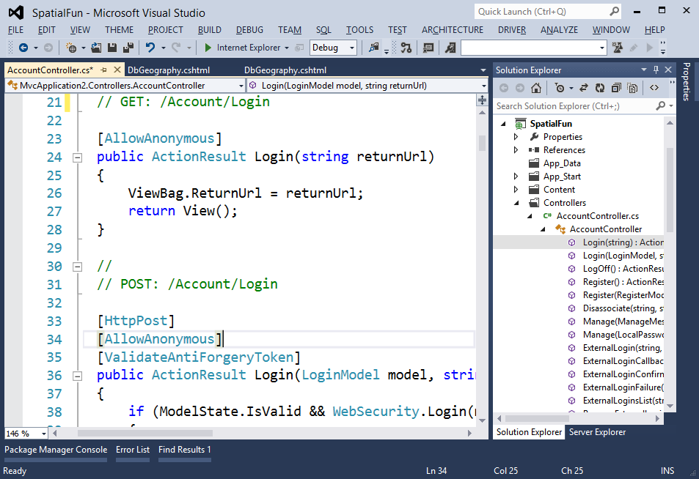
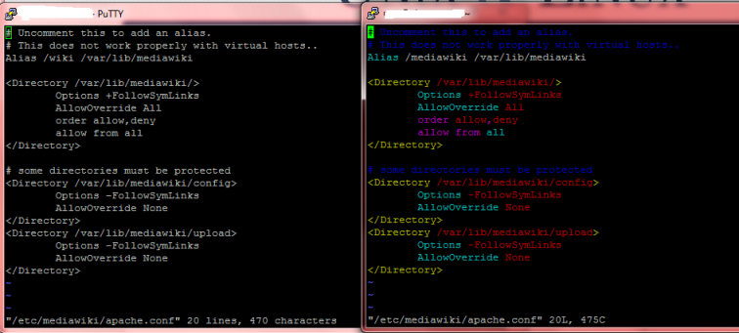
Going from Windows to Linux
Windows environment
Cygwin
Visual Studio
Makefiles?
Compiler settings: debug mode?
Compiler optimization
New compiler → PGI Compiler

Slide 4
Dynamic Model Builder
C++ program that builds chemical reactor models based on user file input
Runs on both Metis and Farber
Performance Gains
Compiler Optimization PGI compiler
Model build: 15 second time → ~ 1 second
ODE solution: 30 seconds → ~ 2 seconds (Non-stiff) ~ 8 seconds (increase in stiffness)

Slide 5
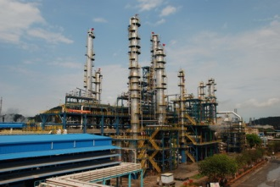
Legacy Code
Model of Naptha in a Continuous Catalytic Reformer
Runs on Farber
Performance Gains
Compiler optimization
On our local desktop “server” on Cygwin → 45 seconds
PGI compiler optimizations → 29 seconds

Slide 6
Profiling
Profiling of Dynamic Model Builder
40% time in the Implicit ODE solvers LU decomposition
Profiling of Legacy Code
70% time in the Implicit ODE solvers LU decomposition

Slide 7
ODE Solver
Optimization Options
Alter Current ODE Solver (CVODEs)
Change to another ODE solver with GPU support

Slide 8
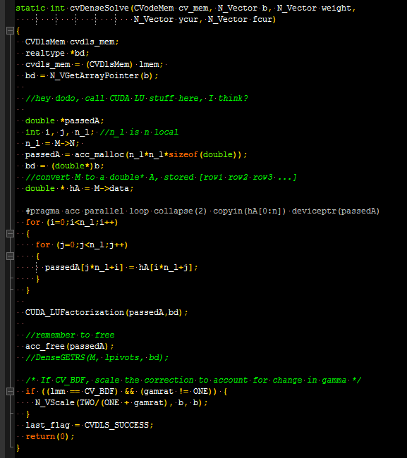
Parallelization Attempts
Attempt 1: Open ACC
CVODEs LU Decomposition did not parallelize well
Attempt 2: CUDA LAPACK LU Decomposition
Applied C++ example to CVODEs code

Slide 9
Current Status
We made the change from Metis to Farber (UD Cluster)
We put in the request for the NVIDIA CUDA Toolkit 7.5
Need to test if changes are correct

Slide 10
Future Goals
Develop a CVODEs that has a GPU based LU decomposition
CUDA
Change dynamic model builder and legacy codes to increase performance
Switch research groups computationally heavy programs to LINUX

Slide 11
Recommendations
CUDA 7.5 Toolkit on everything

Slide 12
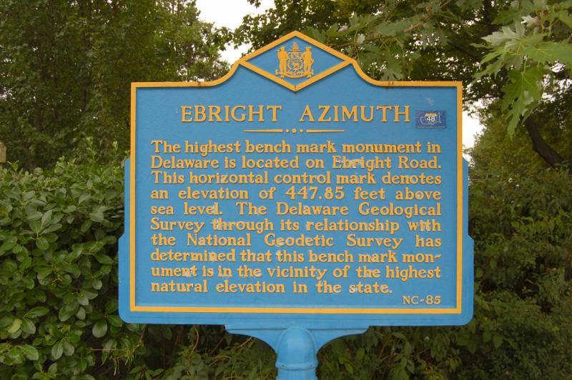
Thanks!

